Slide 1
List of contents
Middle East Wind Turbines
Benchmarks
Mraket Analsys & Regional ranking
Design Lifetime
Design Lifetime of Energy Sources & Typical Range
Factors that Affect Lifetime
End of Life
Bakhtyar karim

Slide 2
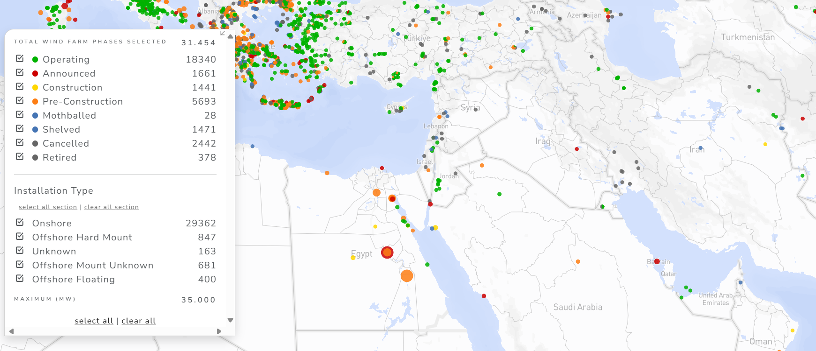
1. Middle East Wind Turbines
Numerous wind turbines are currently operating across the Middle East, we use these existing installations to determine the market position of the Optimus Syria 5 MW class wind turbine in comparison with models already deployed in the region (Turkey, Saudi Arabia, Jordan, Egypt, Iran, Kuwait, UAE, and Israel).
[1], Global Energy Monitor, Maping
Bakhtyar Karim

Slide 3
1.i. Benchmarks
Rank | Country | Turbine Model | Rated Power (MW) | Rotor Diameter (m) | Manufacturer
1 | Israel | GE Cypress 5.x | 5.3 | 160 | GE Renewable Energy
2 | Saudi Arabia | Vestas V150-4.2 | 4.2 | 150 | Vestas
3 | UAE | Goldwind GW155/4500 | 4.5 | 155 | Goldwind
4 | Turkey | Enercon E-101/3000 | 3.0 | 101 | Enercon
5 | Jordan | Vestas V112-3.0 | 3.0 | 112 | Vestas
6 | Egypt | Siemens SWT-2.3-82 | 2.3 | 82 | Siemens
7 | Iran | Saba Niroo S47-660 | 0.66 | 47 | Saba Niroo (Iran)
8 | Kuwait | Gamesa G97-2.0 | 2.0 | 97 | Gamesa
9 | Syria | WDRVM WD2.5-103 | 2.5 | 103 | WDRVM
10 | Egypt | Vestas V47-660 | 0.66 | 47 | Vestas
[1].........[27]
Bakhtyar Karim

Slide 4
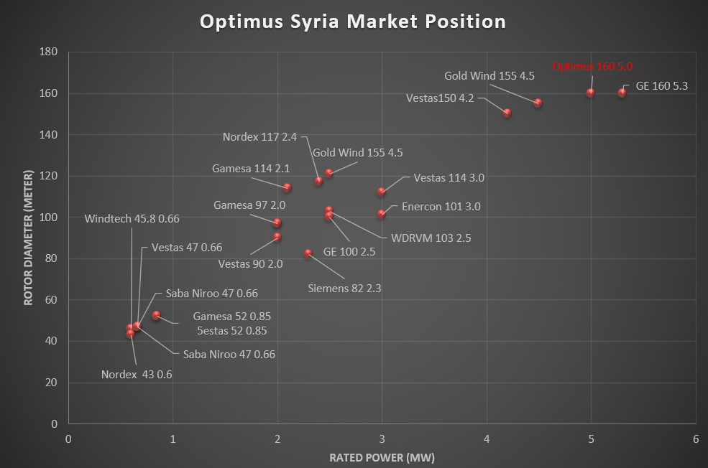
1.ii. Market Analsis & Regional Ranking
[2]........ [27] [28] Self-generated visual content development.
Bakhtyar Karim

Slide 5
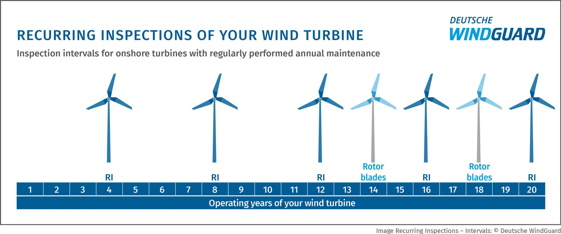
2.Design lifetime
Every modern wind turbine is engineered for a defined service life, this period is determined through detailed design standards such as IEC 61400-1, DNV-ST-0437, and DTU Wind Energy guidelines, which establish requirements for wind classes, loads, and safety margins.
Within this design lifetime, turbines undergo regular annual maintenance and several Recurring Inspections (RI), usually every four years. These inspections are detailed structural checks of the tower, nacelle, drivetrain, and rotor blades to ensure that fatigue, corrosion, and wear remain within safe limits.
The design life represents the timeframe in which the turbine can safely withstand all expected fatigue loads, material stresses, and environmental influences specific to its site. Once this period ends, the structure has reached the limit of its certified design assumptions, meaning continued operation would require new evaluation, inspection, or structural verification.
[29], [30], [31],
Recurring Inspections of Your Wind Turbine, Onshore Inspection Intervals , [33]
Bakhtyar Karim

Slide 6
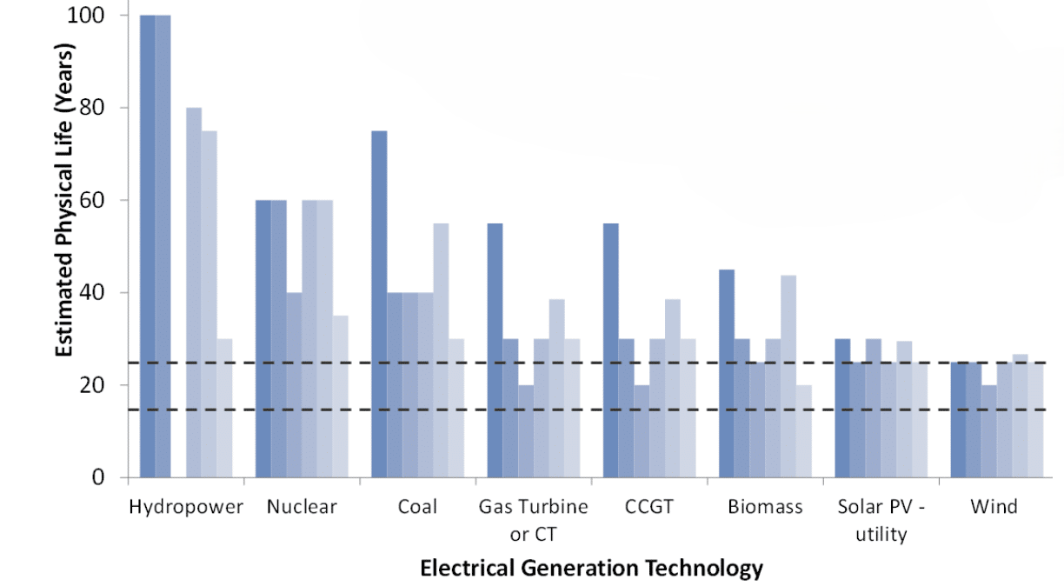
2.i. Design Lifetime of Energy sources & Typical Range
Life Span of wind turbine by Shrink [39]
Turbine Type | Environment | Expected Design Life
Onshore (modern) | Normal turbulence | 20–25 years
Coastal / dusty | Higher fatigue & corrosion | 18–22 years
Offshore | Salt + humidity + wave loading | 25–30 years
[29], [30], [31]
Bakhtyar Karim

Slide 7
2.ii. Factors that affect Lifetime
Category | Influence on Turbine | Result / Outcome
Wind & Loads | Higher wind speed, turbulence, and gusts increase cyclic loading and stress levels. | Accelerated fatigue damage, reduced lifetime in turbulent/coastal areas.
Materials & Manufacturing | Quality of steel, composites, and welds determines resistance to fatigue and cracking. | High quality materials extend lifetime, poor manufacturing causes early structural failure.
Control System | Smooth and responsive pitch/yaw control reduces dynamic loads and prevents overspeed conditions. | Stable operation and lower fatigue, poor control shortens life due to load peaks.
Maintenance Quality | Regular inspection, lubrication, and component replacement prevent damage progression. | Extends lifetime by minimizing wear, corrosion, and bearing failures.
Environment | Temperature variation, humidity, dust, and salt exposure affect corrosion and erosion rates. | Harsh environments (coastal, desert) reduce lifetime unless protective coatings are used.
Operational Time | Higher capacity factor and more operating hours increase fatigue load cycles. | Greater annual use means higher damage accumulation means shorter design life.
[31], [32], [33], [30]
Bakhtyar Karim

Slide 8
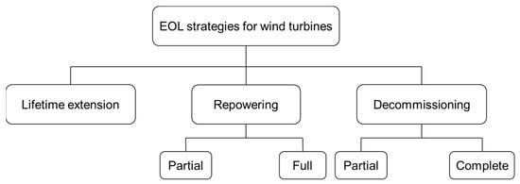
3. End of Life
End of Life Strategies for Wind Turbines, [36]
Strategy | Meaning | Relation to Lifetime
Lifetime Extension | Continue using the same turbine beyond its 20–25 years design life after detailed technical inspections and reevaluation. | Directly extends the lifetime of the existing turbine, most cost effective if structural safety is confirmed.
Repowering | Replace major components or the entire turbine with new technology on the same site. Partial = reuse tower/foundation; Full = complete replacement. | Resets the lifetime, a new turbine begins a new 20–25 years design life.
Decommissioning | Remove the turbine completely from service. Partial = remove top components only, Complete = dismantle everything. | Ends the lifetime permanently, no further operation possible.
[35], [36], [38],
Bakhtyar Karim

Slide 9
Bibliography / Managment Team / PM
[1] Middle East Turbines, Tracker Map - Global Energy Monitor [Accessed: 23 Oct-2025].
[2] The Wind Power, "Windtec Floda 600 – Israel (Golan Heights)", [Online]. Available: https://www.thewindpower.net. Accessed: 23 Oct. 2025.
[3] The Wind Power, "Nordex N43/600 – Egypt (Zafarana-1)", [Online]. Available: https://www.thewindpower.net. Accessed: 23 Oct. 2025.
[4] Scribd, "Vestas V47-660 – Egypt (Zafarana) & Iran (Manjil/Binaloud)", [Online]. Available: https://www.scribd.com. Accessed: 23 Oct. 2025.
[5] The Wind Power, "Saba Niroo S47-660 – Iran (Manjil area)", [Online]. Available: https://www.thewindpower.net. Accessed: 23 Oct. 2025.
[6] The Wind Power, "Vestas V52-850 – UAE (Sir Bani Yas Wind Farm)", [Online]. Available: https://www.thewindpower.net. Accessed: 23 Oct. 2025.
[7] Scribd, "Gamesa G52-850 – Egypt (Zafarana Phases 5–7)", [Online]. Available: https://www.scribd.com. Accessed: 23 Oct. 2025.
[8] MWPS Wind Turbines Media & The Wind Power, "Siemens SWT-2.3-82/93 – Egypt (Gabal El-Zeit / Gulf of Suez)", [Online]. Available: https://www.thewindpower.net. Accessed: 23 Oct. 2025.
[9] en.wind-turbine-models.com, "Gamesa G97-2.0 – Jordan (Ma’an)", [Online]. Available: https://en.wind-turbine-models.com. Accessed: 23 Oct. 2025.
[10] The Wind Power, "GE 2.5-100 – Turkey (Widely Used)", [Online]. Available: https://www.thewindpower.net. Accessed: 23 Oct. 2025.
[11] The Wind Power, "WDRVM WD2.5-103 – Syria (Homs)", [Online]. Available: https://www.thewindpower.net. Accessed: 23 Oct. 2025.
[12] The Wind Power, "Gamesa G114-2.1 – Jordan (Al-Rajef 86 MW)", [Online]. Available: https://www.thewindpower.net. Accessed: 23 Oct. 2025.
[13] The Wind Power, "Nordex N117/2400 – Turkey (Common Installs)", [Online]. Available: https://www.thewindpower.net. Accessed: 25 Oct. 2025.
[14] en.wind-turbine-models.com, "Enercon E-101/3000 – Turkey (Various Projects)", [Online]. Available: https://en.wind-turbine-models.com. Accessed: 25 Oct. 2025.
[15] "Vestas V112-3.0 – Jordan (Tafila 117 MW)", [Online]. Available: https://stopthesethings.com. Accessed: 25 Oct. 2025.
Bakhtyar Karim

Slide 10
Bibliography / Managment Team / PM
[16] Power Technology, "Vestas V150-4.2 – Saudi Arabia (Dumat Al-Jandal)", [Online]. Available: https://www.power-technology.com. Accessed: 25 Oct. 2025.
[17] The Wind Power, "Goldwind GW121/2500 – UAE (Sir Bani Yas Phase)", [Online]. Available: https://www.thewindpower.net. Accessed: 25 Oct. 2025.
[18] The Wind Power, "Goldwind GW155/4500 – UAE (Sir Bani Yas Phase)", [Online]. Available: https://www.thewindpower.net. Accessed: 25 Oct. 2025.
[19] Kuwait Institute for Scientific Research (KISR), "Gamesa G97-2.0 – Kuwait (Shagaya 5×G97)", [Online]. Available: https://www.kisr.edu.kw. Accessed: 25 Oct. 2025.
[20] IJERA Journal, "Vestas V90-2.0 – Kuwait (Technical Studies for Shagaya)", [Online]. Available: https://www.ijera.com. Accessed: 25 Oct. 2025.
[21] Renewables Now & Yahoo Finance, "GE Cypress 5.x – Israel (Genesis/Bereshit 39× GE)", [Online]. Available: https://renewablesnow.com. Accessed: 25 Oct. 2025.
[22] The Wind Power, "Vestas V112-3.0 – Turkey (Numerous Farms)", [Online]. Available: https://www.thewindpower.net. Accessed: 25 Oct. 2025.
[23] en.wind-turbine-models.com, "GE 2.5-103 – Turkey (Widely Used)", [Online]. Available: https://en.wind-turbine-models.com. Accessed: 25 Oct. 2025.
[24] Power Technology, "Iran – Predominantly Vestas V47-660 and Saba S47-660 (0.66 MW Ø47 m)", [Online]. Available: https://www.power-technology.com. Accessed: 25 Oct. 2025.
[25] Oxford Business Group, "Qatar – No Utility-Scale Wind Farms Confirmed; Solar Policy Focus", [Online]. Available: https://oxfordbusinessgroup.com. Accessed: 25 Oct. 2025.
[26] KISR, "Kuwait – Shagaya Wind Farm (5 × Gamesa G97-2.0, Ø97 m)", [Online]. Available: https://www.kisr.edu.kw. Accessed: 25 Oct. 2025.
[27] The Wind Power, "Egypt – Zafarana (N43-600, V47-660, G52-850) and Gulf of Suez/Gabal El-Zeit (Siemens 2.3 MW)", [Online]. Available: https://www.thewindpower.net. Accessed: 25 Oct. 2025.
[28] Self-generated visual content development, 20.10.2025.
[29] International Electrotechnical Commission (IEC), IEC 61400-1: Wind Turbines – Part 1: Design Requirements, Geneva, 2023.
[30] Det Norske Veritas (DNV), DNV-ST-0437: Loads and Site Conditions for Wind Turbines, Oslo, 2023.
Bakhtyar Karim

Slide 11
Bibliography / Managment Team / PM
[31] DTU Wind Energy, LifeWind Project – Assessment Methods for Structural Lifetime Extension, Technical University of Denmark, Roskilde, 2020.
[32] Sandia National Laboratories, Wind Turbine Life Extension: Fatigue and Structural Assessment Approaches, SAND2018-4752, Albuquerque, 2018.
[33] Deutsche WindGuard, "Recurring Inspections of Your Wind Turbine – Onshore Inspection Intervals," [Online]. Available: https://www.windguard.com. Accessed: 27 Oct. 2025.
[34] DTU Wind Energy, Optimal Decision Making for Life Extension of Wind Turbines, Technical Report, Technical University of Denmark, 2021.
[35] IEA Wind Task 42, "Recommendations on Standards and Regulatory Frameworks for Lifetime Extension," [Online]. Available: https://iea-wind.org. Accessed: 27 Oct. 2025.
[36] Topham, E. et al., "End-of-Life Strategies for Wind Turbines – Life Extension, Repowering, and Decommissioning," Energies, vol. 12, no. 18, p. 3746, 2019.
[37] DTU Wind Energy, Guidelines for Structural Health Monitoring and Inspection Planning in Wind Turbines, Technical University of Denmark, 2016.
[38] Det Norske Veritas (DNV), DNV-SE-0190: Project Certification of Wind Power Plants, Oslo, 2023.
[39] Shrink That Footprint, “Wind Turbine End-of-Life Loop – Repowering, Recycling, and Lifetime Extension,” [Online]. Available: https://shrinkthatfootprint.com/wp-content/uploads/2023/05/image-16.png. Accessed: 27 Oct. 2025.
Bakhtyar Karim

